Slide 1
Home Loan default Prediction
Sprint 2

Slide 2
Problem Statement
How might we use machine learning to predict home loan defaults such that we can reduce financial losses and improve loan management?
Proposed Solution:
Develop machine learning models to predict home loan defaults.
Use advanced techniques to improve model accuracy and reliability.
Potential Impact:
Reduced financial losses for lenders.
Better loan management and decision-making processes.
Improved financial stability and customer satisfaction.

Slide 3
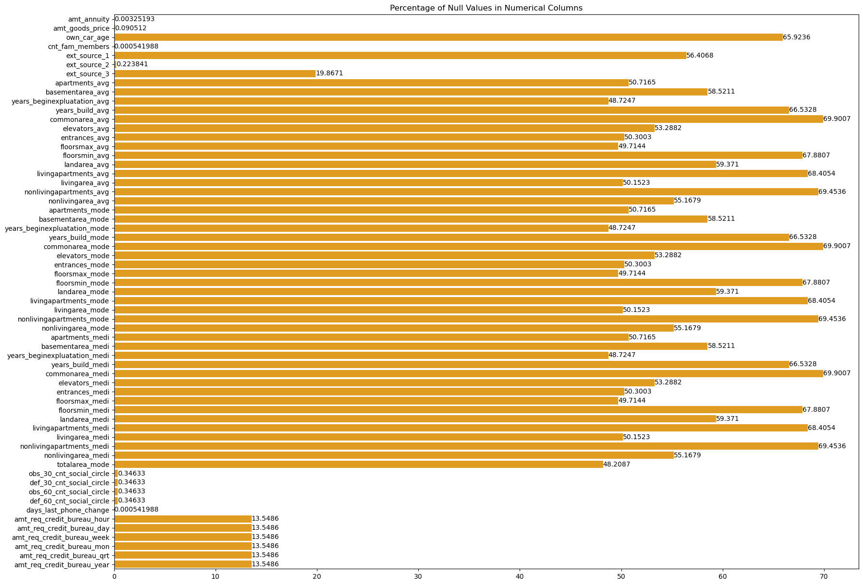
Dataset and Preprocessing
Dataset Shape: (184506, 122)
Deleted more than 20% of NULL
The total number of rows dropped is 64306
The percentage of rows dropped is 34.85%
Backward Filling method
Forward Filling method

Slide 4
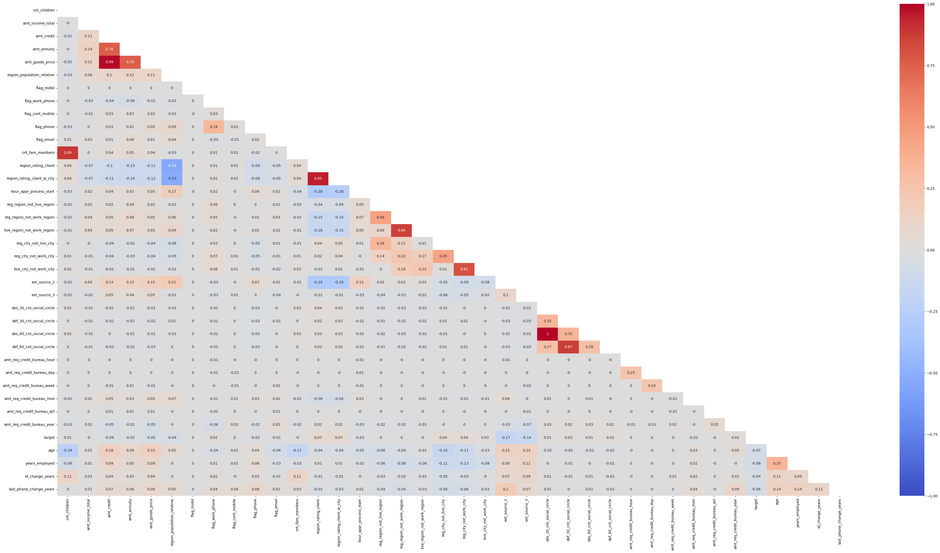
Key Findings from EDA
Imbalanced Dataset – Target Variable
0 91.314867
1 8.685133
Severe Negative correlations with Age and Own car Variable
Severe Positive correlations with price of home and amount of loan
Over 10 variables with P-values over 0.05
10 Object variables were converted to numerical variables
Severe Multicollinearity issues – 15 variables with inf values
Final Dataset Shape: (151158, 71)

Slide 5
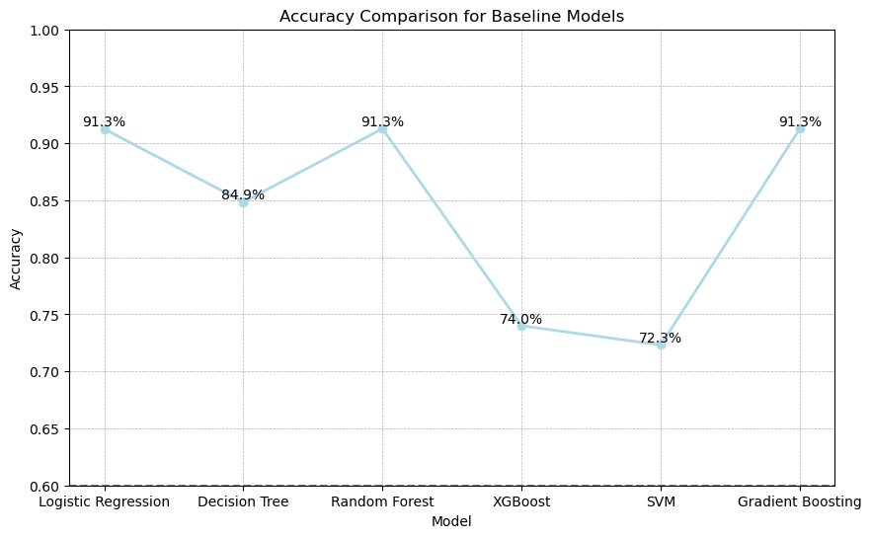
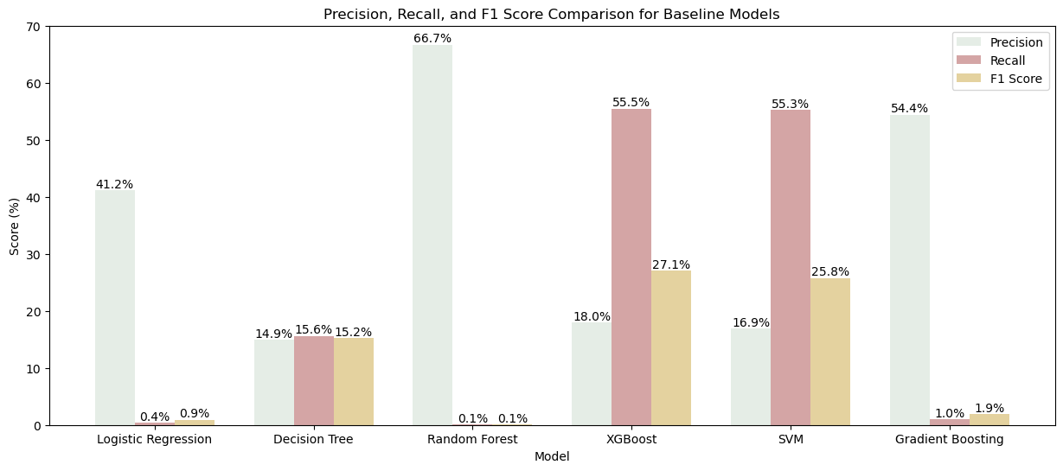
Baseline Models and Evaluation
Models Evaluated(With SMOTE and without):
Logistic Regression
Decision Tree
Random Forest
XGBoost
SVM
Gradient Boosting
Evaluation Metrics:
Accuracy
Precision
Recall
F1 Score
Best out of the 6 models were SVM and XGBoost with similar Recall and Precision

Slide 6
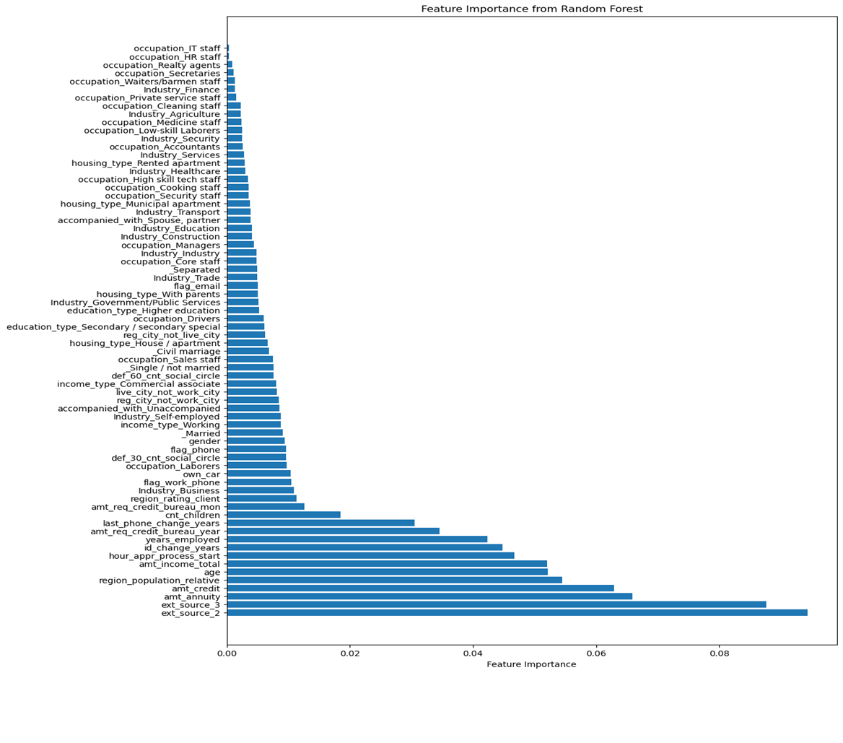
Advanced Modeling and Future Work
Hyperparameter tuning using GridSearchCV or RandomizedSearchCV.
Implementing ensemble methods like stacking.
Stratified k-fold cross-validation
Use feature importance scores from models like Random Forests or XGBoost
Evaluate the Receiver Operating Characteristic (ROC) curve and Area Under the Curve (AUC)

Slide 7
Thank you ☺

